Slide 1
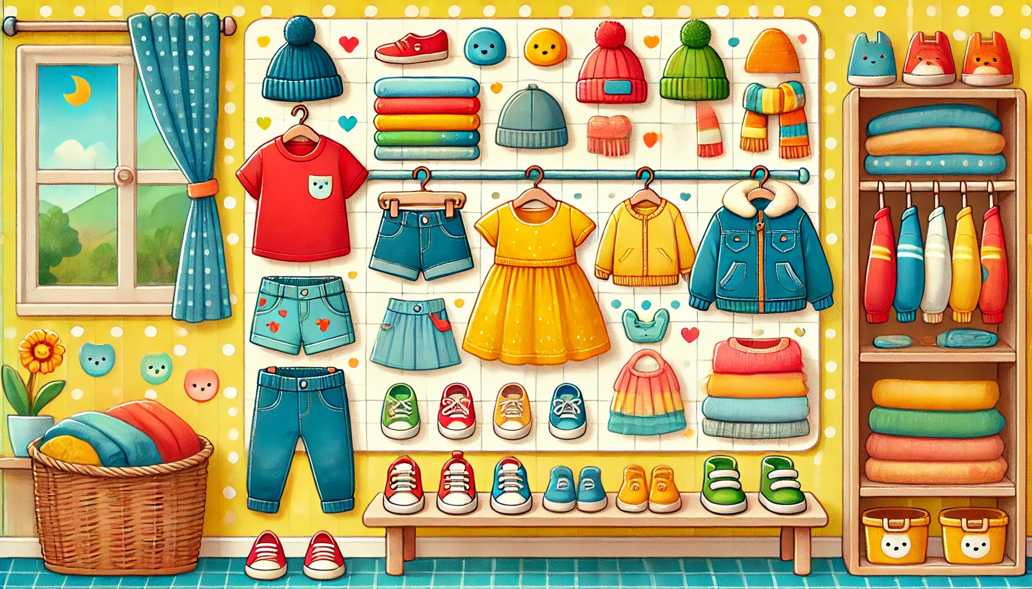
My Wardrobe
Coloring Book

Slide 2
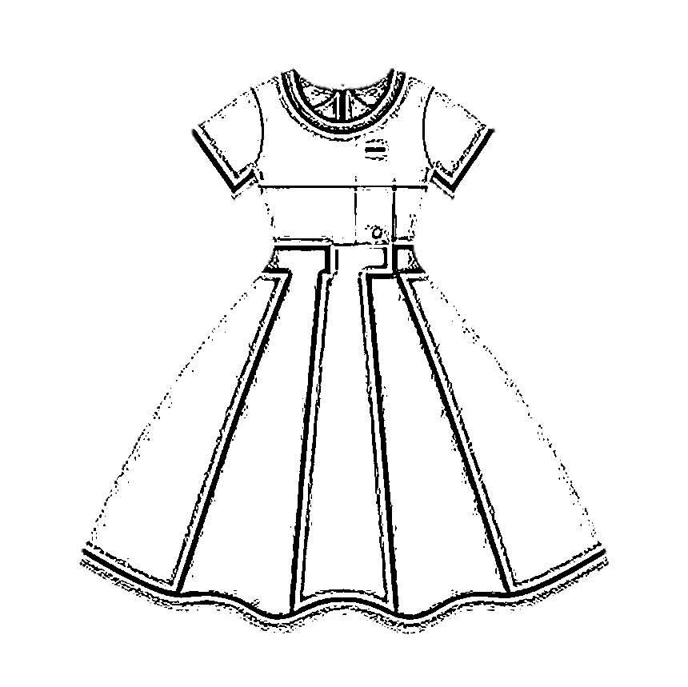
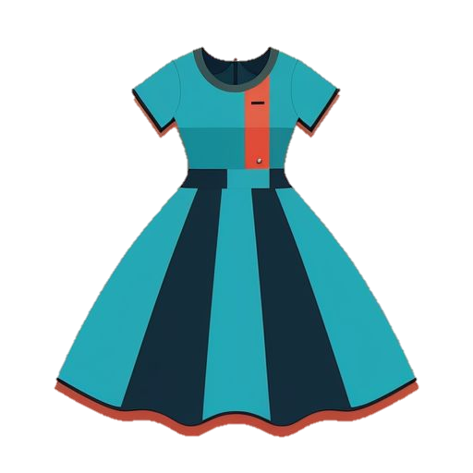
Trace & Color
My Wardrobe
Dress

Slide 3
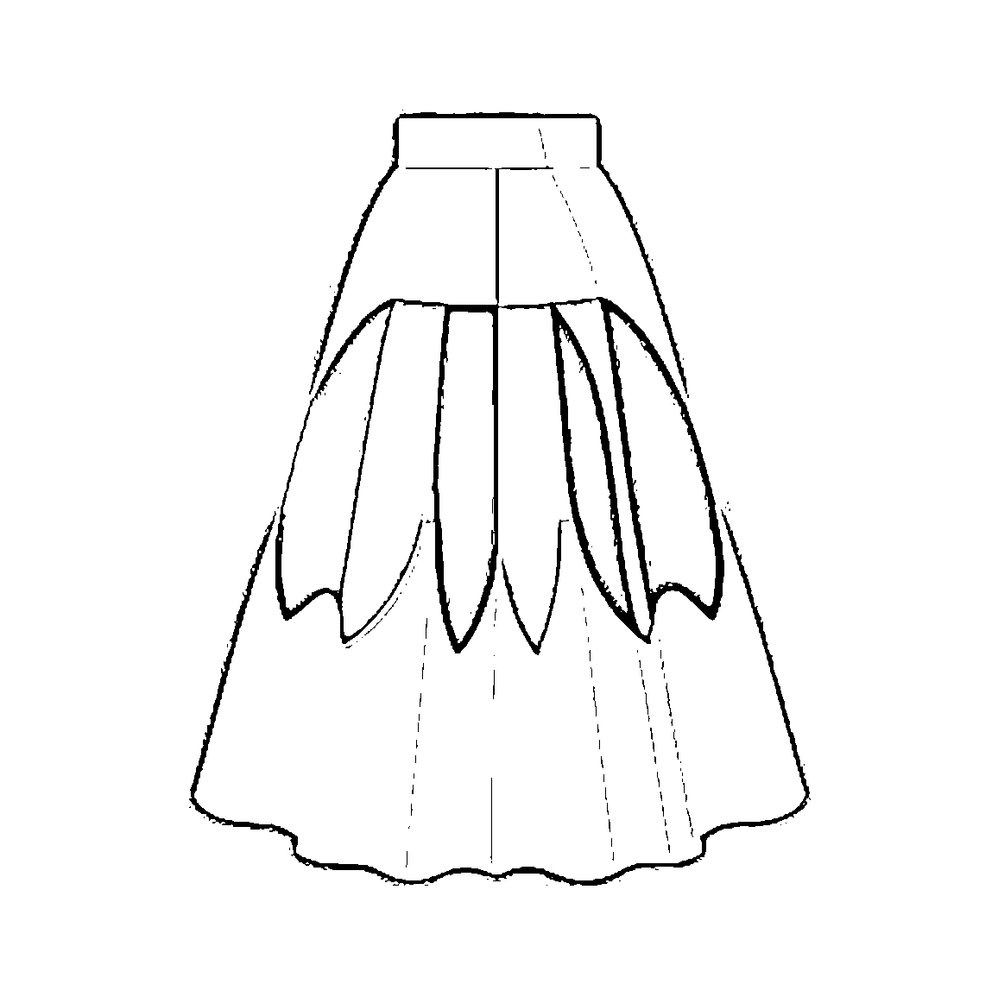
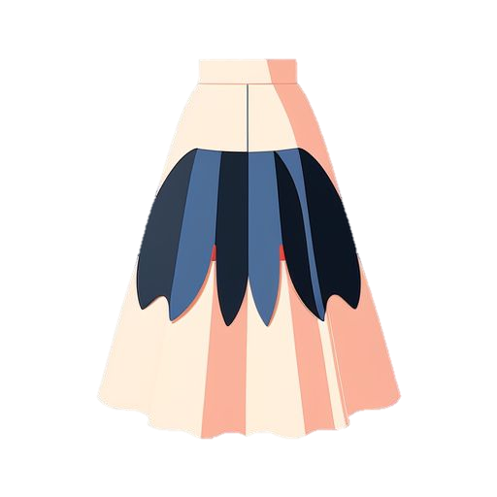
Trace & Color
My Wardrobe
Skirt

Slide 4
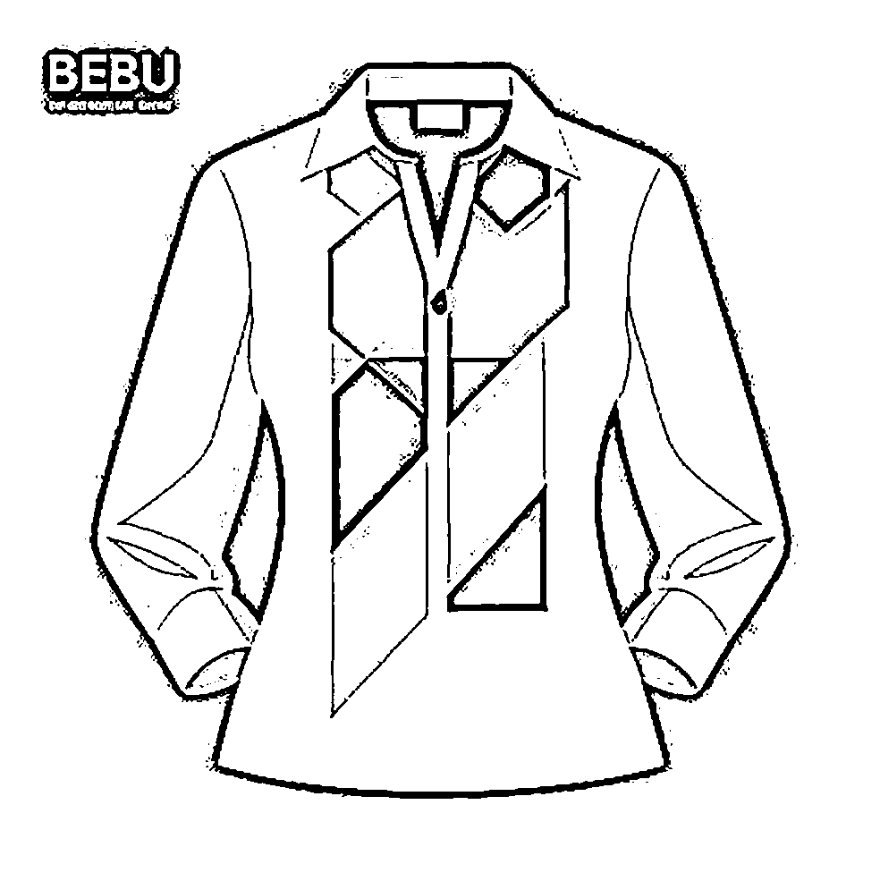
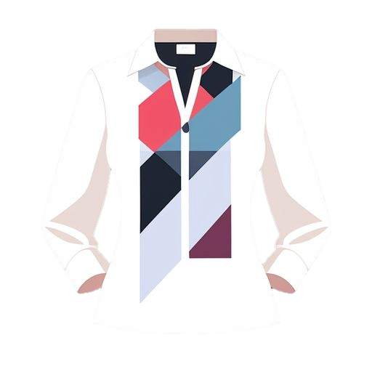
Trace & Color
My Wardrobe
Blouse

Slide 5
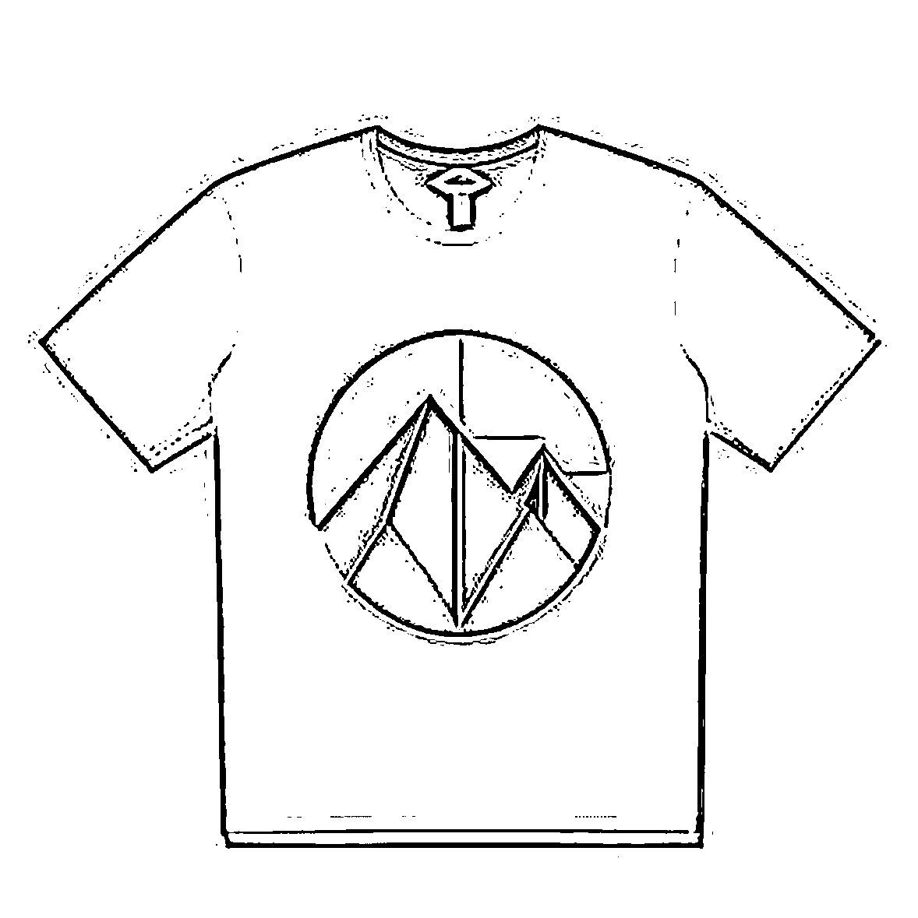

Trace & Color
My Wardrobe
T-shirt

Slide 6
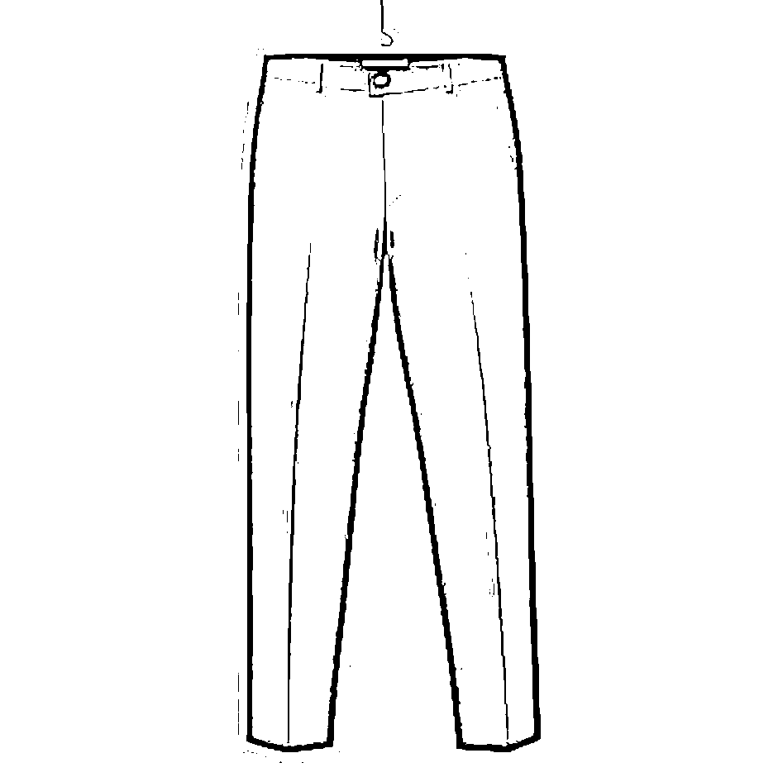
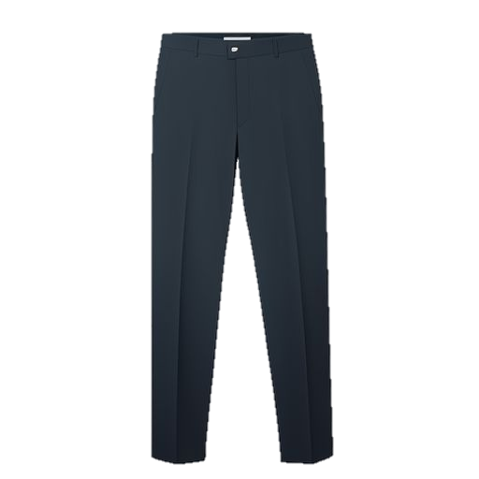
Trace & Color
My Wardrobe
Trousers

Slide 7
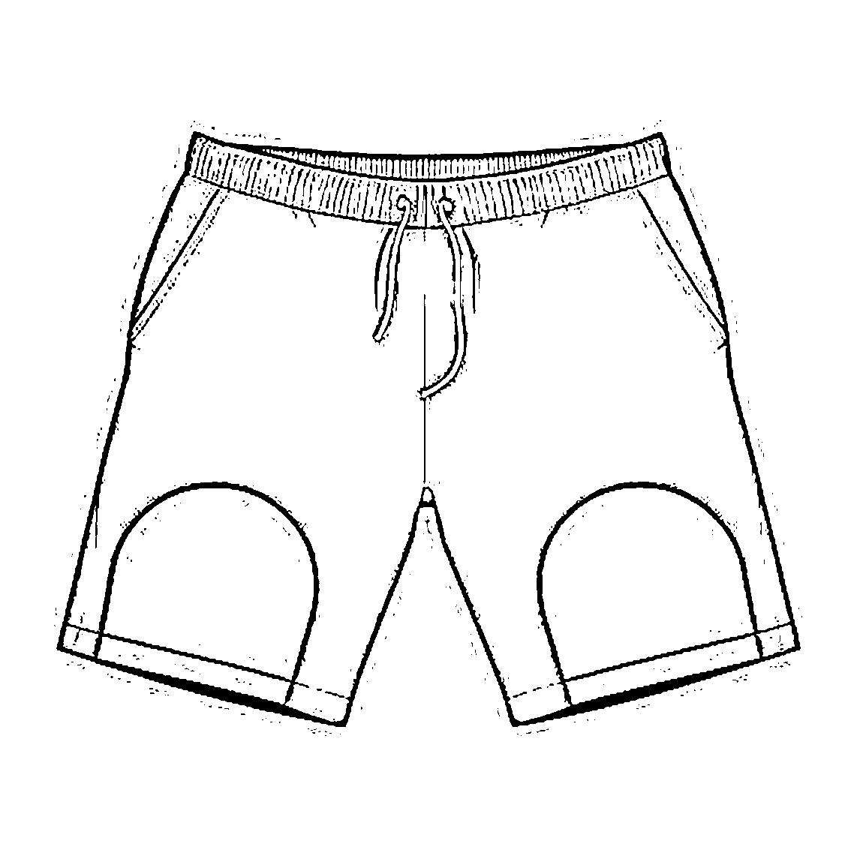

Trace & Color
My Wardrobe
Shorts

Slide 8
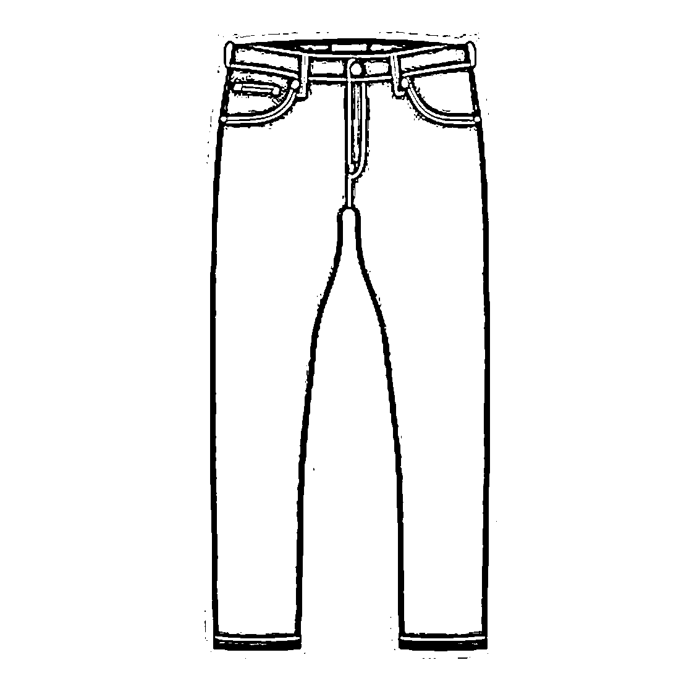
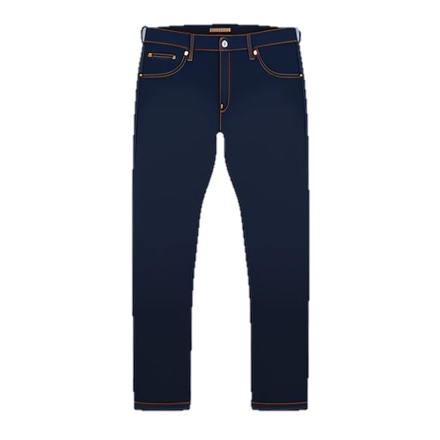
Trace & Color
My Wardrobe
Jeans

Slide 9

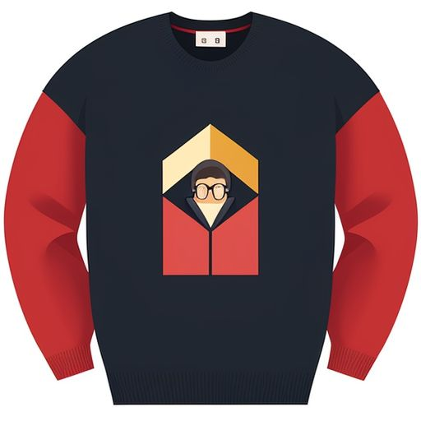

Trace & Color
My Wardrobe
Jumper

Slide 10
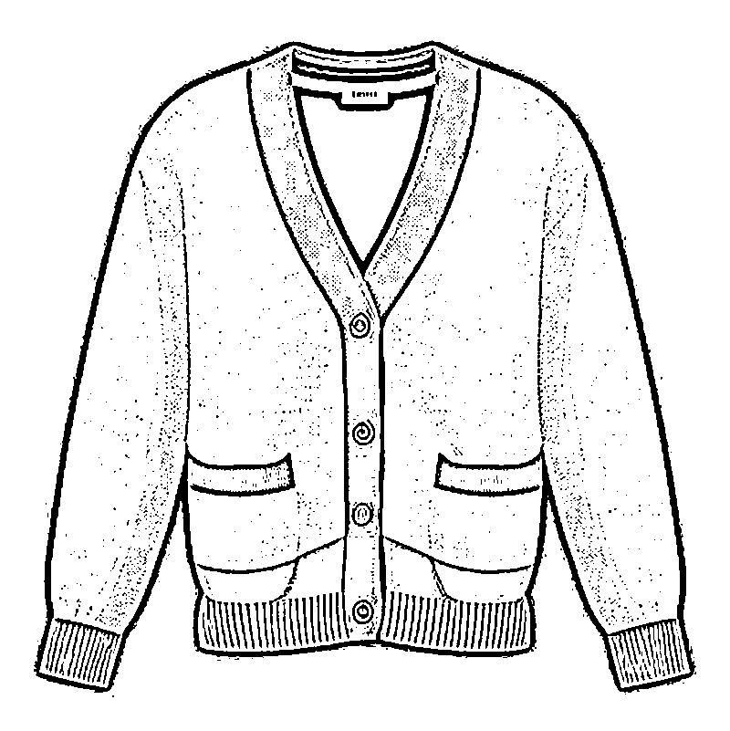


Trace & Color
My Wardrobe
Cardigan

Slide 11


Trace & Color
My Wardrobe
Coat

Slide 12
Trace & Color
My Wardrobe
Pajamas

Slide 13
Trace & Color
My Wardrobe
Vest

Slide 14
Trace & Color
My Wardrobe
Pants

